Slide 1


COVID - 19
Presented by:
Rohit Shankar Panigrahi Regd ID-1701110120
Subhransu Sekhar Sahoo
Regd ID-1701110012
Global Prediction using Python.

Slide 2
AGENDA
What we will be doing?
Covid-19 Data
What is Random Forest?
Why use Random Forest?
How does Random forest Work?
Code

Slide 3
What will we be doing?
We will be using Covid-19 Module using data scraping and learning to predict how many confirmed cases and fatalities will be there on an these day globally.

Slide 4
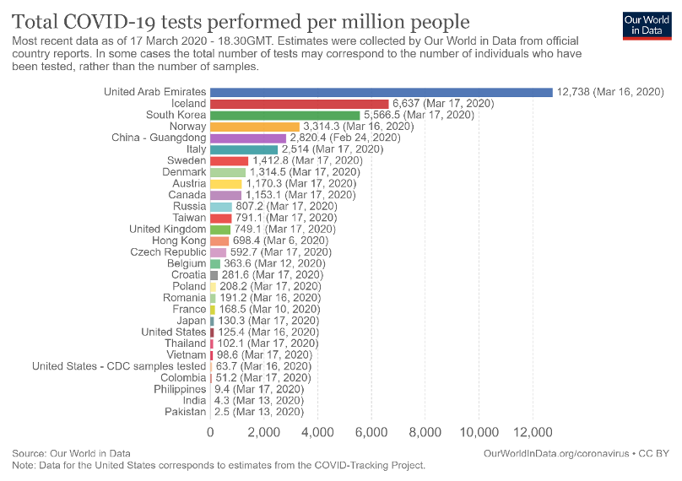
Covid-19 Data
Covid-19 Data/Module is an open source and contains information about countries, their population and confirmed and fatalities on given dates. We have data in train and test sets.

Slide 5

What is Random Forest?
Random Forest is a supervised learning algorithm. It is an ensemble method in which we use multiple decision tree and use them to make decisions to predict future possibilities and on-going Incidents.

Slide 6
Why we use Random Forest?
Random forest is used to solve a wide variety of challenges, because of several benefits it provide such as:
No overfitting
High Acurracy
Deal with missing Data
Somehow these are also the concept of Machine Learning,Data Visualization
And Natural Image Processing.

Slide 7


How it works?
In Random Forest we train multiple Decisions Trees.
Then when making predictions we make the predictions using all decision trees.
The prediction made by the majority of the decision trees is what is considered final decision of the random forest
True
False
True
= True

Slide 8
Referral
Covid Tracking(India): https://covidindia.org/
Covid Tracking(Global): https://covid19.who.int/
Understanding Random Forest: https://towardsdatascience.com/understanding-random-forest-58381e0602d2
Code(GitHub):

